Slide 1


MILESTONE 4
Integrating Finger Count Gesture and microphone volume control
Mentor : Dr. D. Bhanu Prakash
TEAM B
KAKI SATVIKA
KARTHIKA GOPALAKRISHNAN
KARUTURI RISHITHA
MAJJI HARI KRISHNA

Slide 2


PROBLEM STATEMENT
Integrating Finger Count Gesture with System-level Microphone Volume control
Implement a Finger-count based Volume control ( 0 – 5 fingers → 0 – 100% ).
Volume control will be executed using Pycaw or equivalent libraries (PyAutoGUI) with smooth transitions.
Output :
Real-time webcam input feed with microphone volume control
Hand landmarks overlayed on the video stream
Smooth volume transition will be implemented to enhance the user experience
Users will able to use the application without any additional hardware beyond a standard webcam.
3

Slide 3
Modules & Technologies used
OpenCV – Webcam video capture and processing
Media pipe – Hand tracking and Gesture Detection
Pycaw – Manages/Controls windows system volume through Core Audio APIs
COM interfaces – (COM initialization + COM Object activation) Manages Audio endpoints
Keyboard (Global Hotkeys) – Optional fallback volume control
Streamlit - Converts Python scripts into a web app

Slide 4
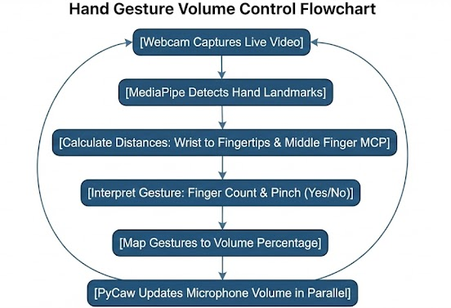
Working process
Webcam capturing live video
Media pipe detects hand landmarks
Distance between wrist point to finger tips and middle finger MCP
Gesture interpretation (Finger count and Pinch – Yes/No)
Gestures mapped to volume percentage
Py caw updates microphone volume in parallel

Slide 5
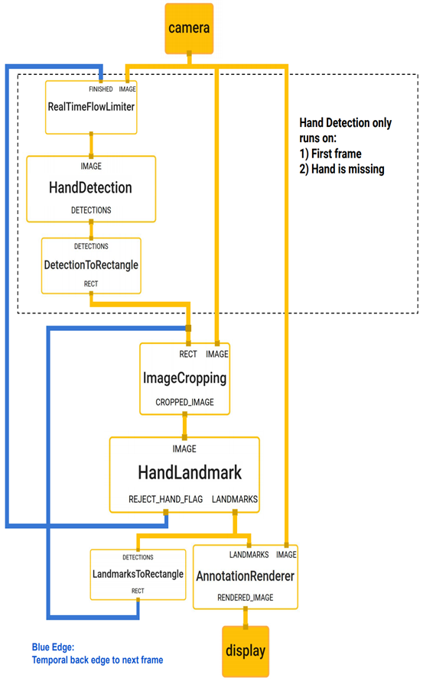
MediaPipe: Overview & Role in Gesture-Based Volume Control
MediaPipe is Google’s cross-platform framework for building real-time
ML pipelines.
Provides pre-trained, lightweight models for hand detection and tracking.
Designed to run efficiently on CPU, enabling smooth real-time performance.
In this project, MediaPipe Hands is used to:
Detect a user’s hand from webcam input
Extract 21 3D hand landmarks
Identify finger states (open/closed)
Produce the finger count used to control microphone volume
Supports integration with OpenCV for real-time visualization.

Slide 6
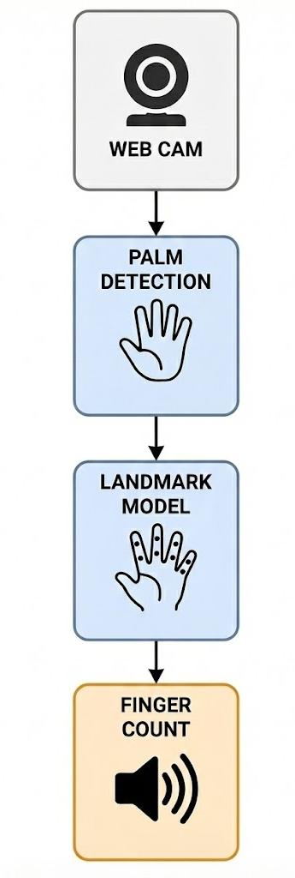
Media Pipe Hands Architecture (Two-Stage Pipeline)
1. Stage 1: Palm Detection Model
A fast, lightweight CNN that detects the hand region.
Outputs a bounding box of the palm.
Initiates the tracking pipeline.
Designed for high accuracy even with occlusion or rotation.
2. Stage 2: Hand Landmark Model
Predicts 21 precise hand landmarks (x, y, z) within the detected box.
Landmarks include fingertips, knuckles, and wrist.
Used to determine finger motions (open/closed).
3 Tracking & Post-processing
Once detected, MediaPipe tracks the hand across frames → improves FPS.
Landmark positions are analyzed to calculate:
Finger state
Finger count (0–5)
Gesture recognition used for volume mapping
Final output is fed to Pycaw/PyAutoGUI for system-level microphone control.

Slide 7
OpenCV: Computer Vision Engine for Real-Time Gesture Processing
OpenCV (Open-Source Computer Vision Library) is a widely used open-source library for image and video processing.
Provides efficient tools for:
➤ Real-time video capture
➤ Image preprocessing
➤ Drawing and visualization
➤ Performance optimization (FPS monitoring)
Supports multiple languages (Python, C++, Java) and runs on CPU efficiently.
Used extensively in Al, robotics, healthcare, gesture recognition, and surveillance applications.
Acts as the primary interface between the webcam and the hand detection model in this project.
7

Slide 8
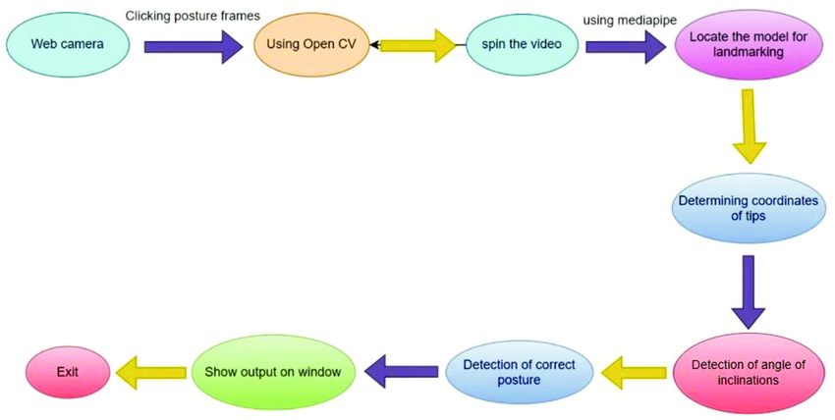
Role of OpenCV in Gesture-Based Microphone Volume Control
Webcam Capture (Video Stream Input)
cap = cv2.VideoCapture(0)
2. Frame Preprocessing
Converts frames BGR → RGB
3. Visualization & Overlay
Draws 21 hand landmarks
4. Real-Time Display & Feedback
Uses cv2.imshow() to show live interface
5. Smooth Performance
Calculates FPS for performance optimization
7

Slide 9
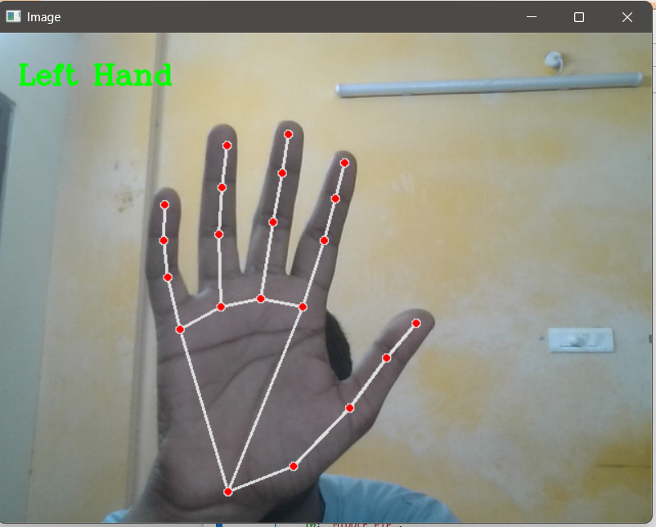
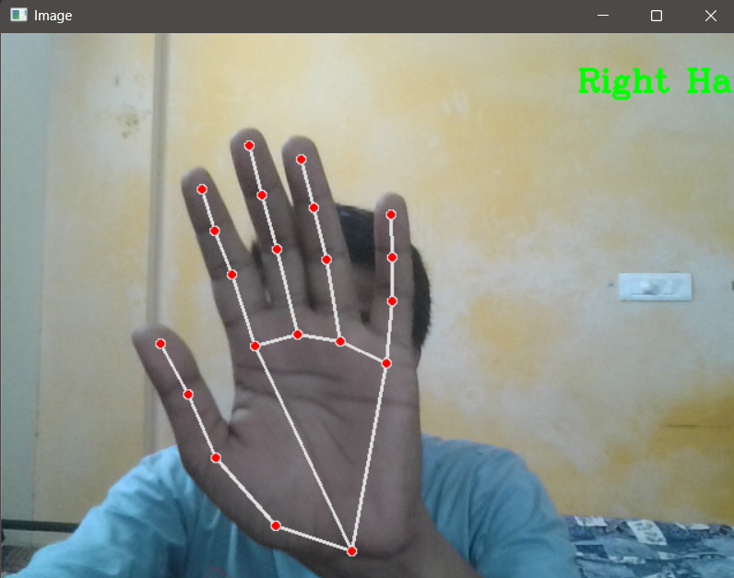
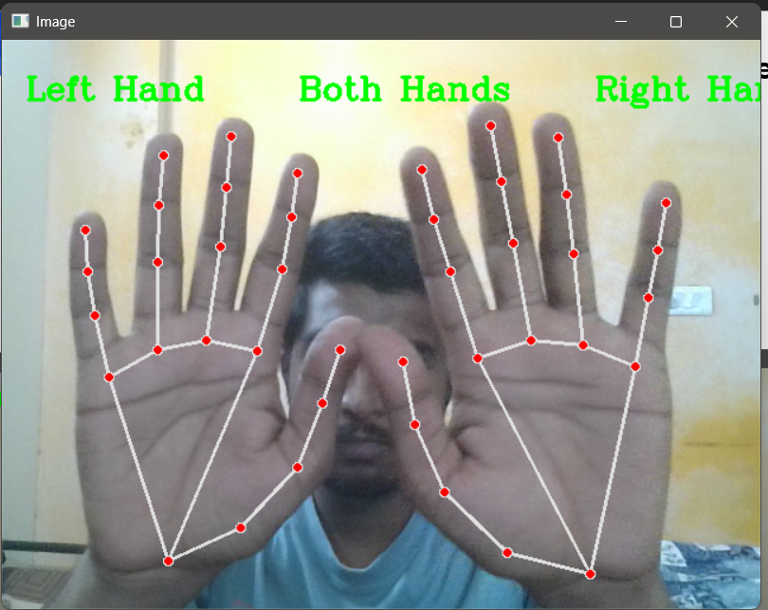
Hand Detection and Labeling
OPENCV2: Webcam access and image processing Interactive web application UI
MEDIAPIPE HANDS: Pre-trained ML model for hand & finger tracking PALM DETECTION – Single Shot Detection model - Detects objects with bounding box
INPUT : Hand Image (RGB) Convolutional Layers Flatten layer Fully Connected Layers OUTPUT: Left hand / Right hand (label with probability/ confidence)
7

Slide 10
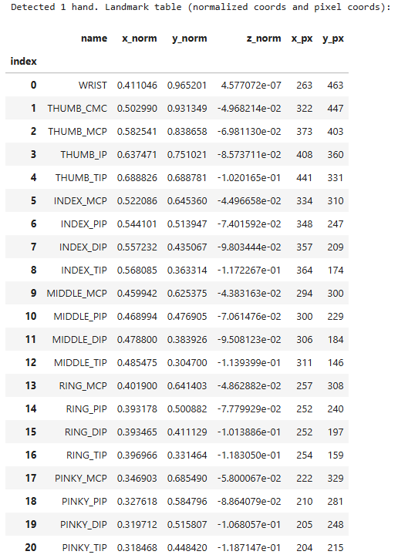
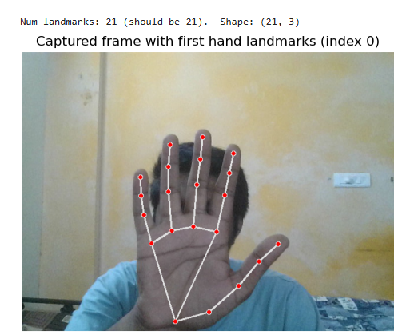
Hand Landmarks and table
REGRESSION CNN MODEL – Depth wise Separable model - Gives continuous value ( value of calculated parameter )
Mobile net Model :
It is a light weight CNN Model
It requires less memory and low computational power
It is Fast
INPUT : Hand Image (RGB) - Convolutional Layers - Global average Pooling - Fully Connected Layers - Dense layers OUTPUT: Pinch Detection ( Yes/ No)
7

Slide 11
Windows Core Audio (WASAPI)
System-level Audio Management API in Windows
Windows Core Audio is the low-level engine that manages all audio devices.
Exposes interfaces like:
IMMDeviceEnumerator → Finds audio devices
IAudioEndpointVolume → Controls volume
IAudioSessionManager → Manages app-level audio
Allows control over:
Microphone levels
Speaker output
Mute/unmute
Audio routing
Pycaw uses this API internally to access device volume.

Slide 12
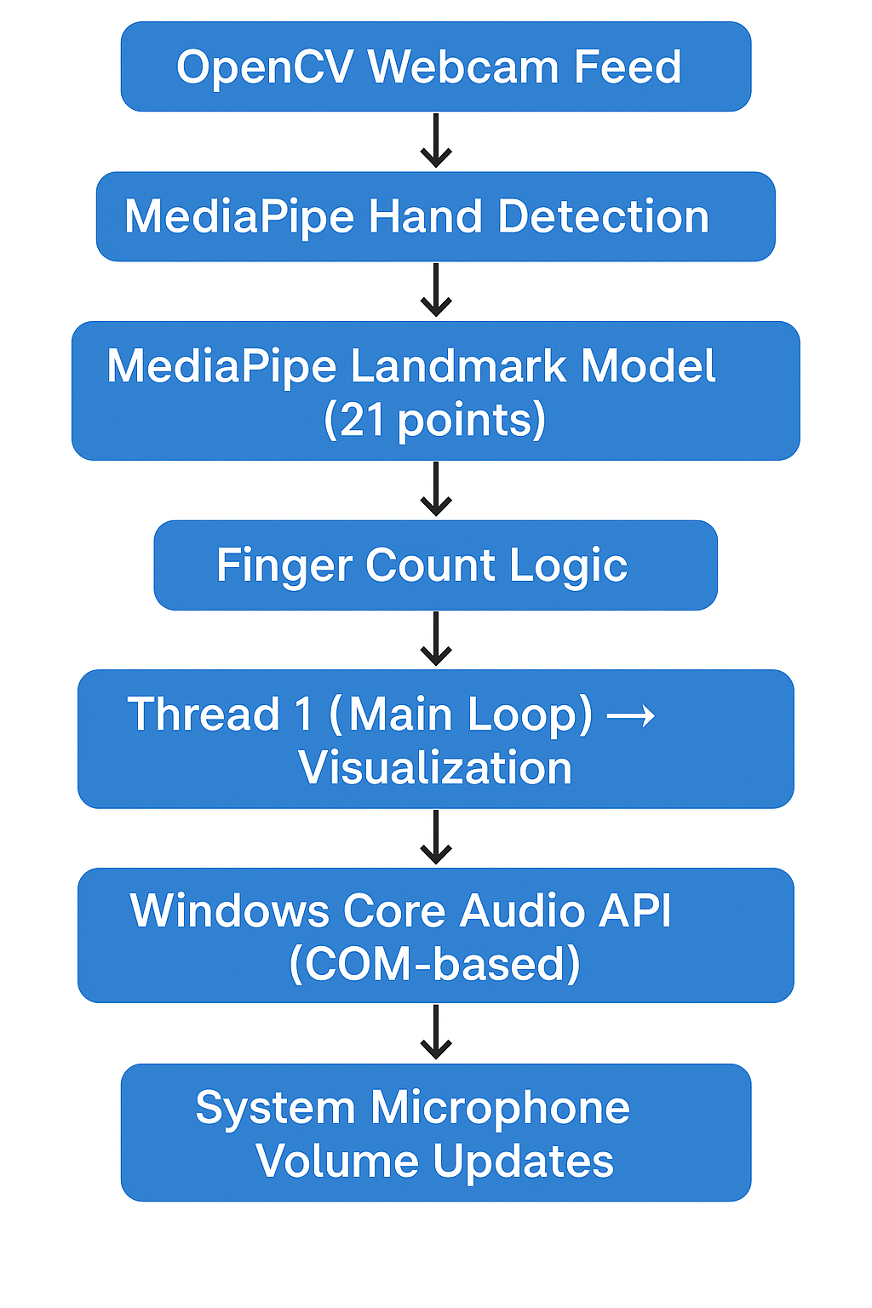
COM (Component Object Model)
The technology Pycaw uses to talk to Windows APIs
Microsoft’s object-based communication architecture.
Windows Core Audio exposes all its features through COM interfaces.
Pycaw → Built on top of COM → Gives us Python access to these devices.
In our project:
COM enables Python to call Windows audio functions
Without COM, Python cannot modify mic/speaker volume
Why Pycaw Uses COM?
COM = Windows’ official way to expose system-level components
Pycaw wraps these COM objects so Python can use them easily
Example:
devices = AudioUtilities.GetSpeakers()
interface = devices.Activate(...)
volume = cast(interface, POINTER(IAudioEndpointVolume)
Activate() is actually a COM call internally

Slide 13
Threading & Multithreading
Threading
Runs a separate lightweight task parallel to the main script.
Useful so volume updates do not freeze the webcam feed.
Multithreading
Multiple threads run concurrently:
Thread 1 → Webcam + MediaPipe
Thread 2 → Volume setting via Pycaw
Thread 3 → FPS / UI updates (optional)
Benefits in our project:
Smooth, uninterrupted hand tracking
Volume control happens instantly
No lag in video feed
Better user experience

Slide 14
Functions - Finger Count Mic-Volume Control
toggle_camera_state()
Switches Streamlit’s run camera variable between ON/OFF.
Controls webcam activation and updates UI button text.
Helps manage the main video-processing loop.
Frame Capture & Preprocessing
Reads frame from webcam and flips it for mirror-view.
Converts BGR → RGB for MediaPipe compatibility.
Provides cleaned input for hand detection.
load_mediapipe()
Loads MediaPipe Hands model with real-time tracking settings.
Returns the hand detector and drawing utility.
Cached for performance using st.cache_resource.

Slide 15
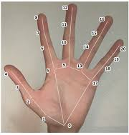
Functions - Finger Count Mic-Volume Control
Drawing Landmarks
Renders hand skeleton and landmarks using OpenCV.
Helps verify correct detection visually.
Useful for debugging hand positions.
Finger Counting Logic
Calculates distance ratios between fingertip and wrist.
Determines whether each finger is OPEN or CLOSED.
Includes special handling for thumb orientation.
Volume Mapping & Control
Converts finger count (0–5) into volume levels (0–100%).
0 fingers → MUTE | 5 fingers → Full Volume.
Uses Pycaw COM interface to set volume smoothly.

Slide 16
get_mic_interface()
Initializes Windows Core Audio through COM.
Retrieves microphone endpoint and returns IAudioEndpointVolume.
Fails safely by returning None if initialization errors occur.
manual_change(change)
Adjusts microphone volume manually through the sidebar.
Ensures volume remains within the valid 0.0–1.0 range.
Uses Pycaw interface to apply the volume change.
Streamlit Metrics Update
Displays real-time microphone volume and finger count.
Shows mute/active status messages.
Provides a clean dashboard experience.
Cleanup
Releases webcam and closes OpenCV windows safely.
Prevents camera lock issues in future runs.
Ensures clean application shutdown.

Slide 17
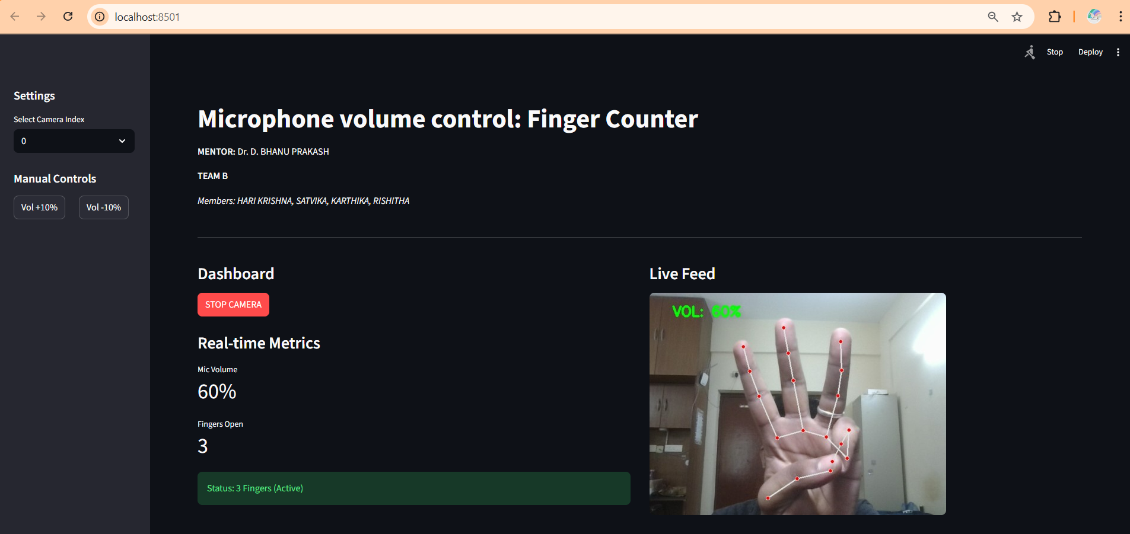
User Interface ( Streamlit )
Interactive Web UI : Converts Python scripts into a web app, replacing basic OpenCV windows with a browser-based interface.
Real-Time Control : Uses buttons and toggles to dynamically control camera and features without restarting.
Live Dashboard : Displays real-time data with clean metrics and live-updating line charts.
State Management: Remembers app settings (like camera on/off) across updates for a smooth user experience.

Slide 18
THANK YOU

